Slide 1
UNIT i Hashing

Slide 2
Content
Hash Table- Concepts-hash table, hash function, bucket, collision, probe, synonym, overflow, open hashing, closed hashing, perfect hash function, load density, full table, load factor, rehashing, issues in hashing, hash functions- properties of good hash function, division, multiplication, extraction, mid-square, folding and universal, Collision resolution strategies- open addressing and chaining, Hash table overflow- open addressing and chaining, extendible hashing.
Dictionary- Dictionary as ADT, ordered dictionaries.
Skip List- representation, searching and operations- insertion, removal.

Slide 3
Searching
Consider the problem of searching an array for a given value
If the array is not sorted, the search requires O(n) time
If the value isn’t there, we need to search all n elements
If the value is there, we search n/2 elements on average
If the array is sorted, we can do a binary search
A binary search requires O(log n) time
About equally fast whether the element is found or not
It doesn’t seem like we could do much better
How about an O(1), that is, constant time search?
We can do it if the array is organized in a particular way

Slide 4
Introduction
With binary search certain data structures such as a binary search tree can help improve the efficiency of searches.
From linear search to binary search, we improved our search efficiency from O(n) to O(logn) .
We now present a new data structure, called a hash table, that will increase our efficiency to O(1) , or constant time.

Slide 5
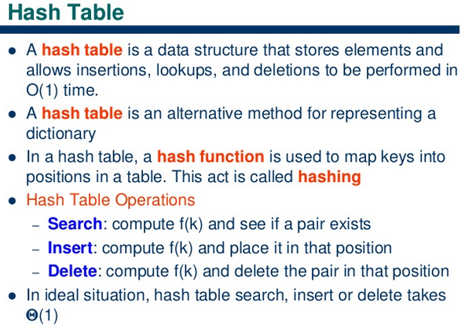

Slide 6
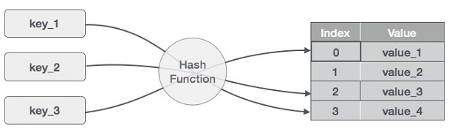
Hash Table
A hash table is made up of two parts: an array (the actual hash table where the data to be searched is stored) and a mapping function, known as a hash function.
The hash function is a mapping from the input space to the integer space that defines the indices of the array.

Slide 7
Hashing is a technique to convert a range of key values into a range of indexes of an array.
In other words, the hash function provides a way for assigning numbers to the input data such that the data can then be stored at the array index corresponding to the assigned number.

Slide 8
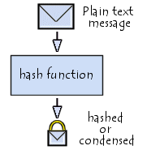
Hash Function
A hash function is a mathematical function that converts a numerical input value into another compressed numerical value.
The input to the hash function is of arbitrary length but output is always of fixed length.
Values returned by a hash function are called message digest or simply hash values

Slide 9
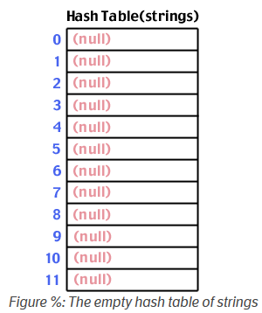
Example
Let's take a simple example.
First, we start with a hash table array of strings (we'll use strings as the data being stored and searched in this example).
Let's say the hash table size is 12:

Slide 10
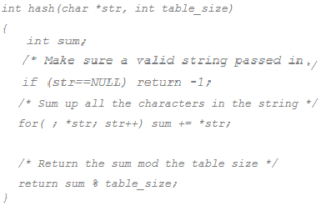
Next we need a hash function.
There are many possible ways to construct a hash function. We'll discuss these possibilities after few slides.
For now, let's assume a simple hash function that takes a string as input. The returned hash value will be the sum of the ASCII characters that make up the string mod the size of the table:

Slide 11
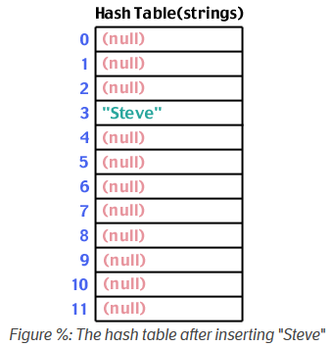
Now that we have a framework in place, let's try using it. First, let's store a string into the table: "Steve".
We run "Steve" through the hash function, and find that hash("Steve",12) yields 3:
S:83 t:116 e:101 v:118
83+116+101+118+101=519
519%12=3

Slide 12
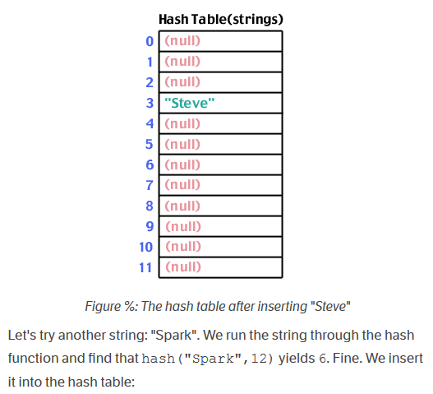

Slide 13
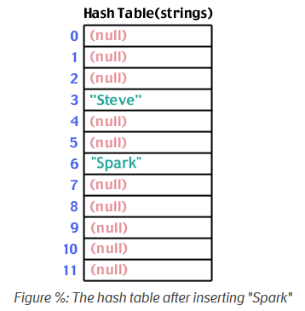
This method is know as “Division Hash Method”

Slide 14
Hashing Methods
Direct Hashing
Modulo Division Method
Digit Extraction Method
Midsquare Method
Folding Method

Slide 15
Direct hashing
Direct hashing, the key is the address without any algorithmic manipulation.
The data structure must therefore contain an element for every possible key.
While the situations where direct hasing are limited, when it can be used it is very powerful becasue it guarantees that there are no collisions.
Limitations: Large key value.

Slide 16
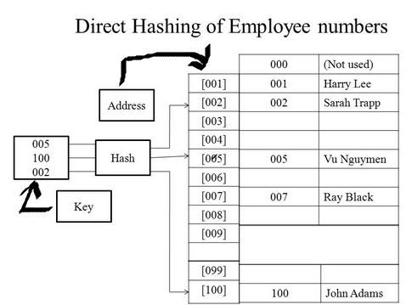

Slide 17
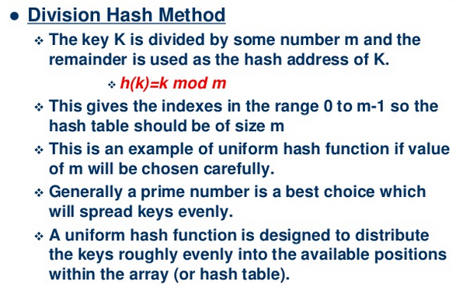
Division hash method / modulo division method

Slide 18
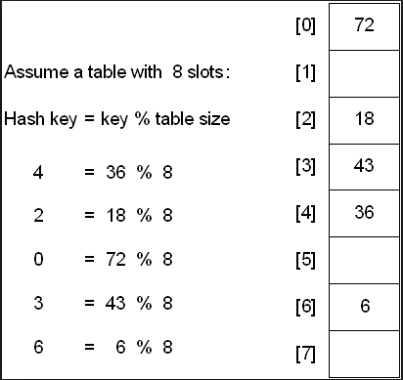
Modulo-Division
Modulo-Division Also known as Division-remainder. Address = Key MOD Table size
While this algorithm works with any table size, a list size that is a prime number produces fewer collisions than other list sizes.

Slide 19
Digit Extraction Method
Works based on the distribution of digits or characters in the key.
Using digit extraction, selected digits are extracted from the key and used as the address.
More evenly distributed digit positions are extracted and used for hashing purposes.
Very fast but digits/characters distribution in keys may not be very even

Slide 20
For example, using a six-digit employee number to hash to a three-digit address(000-999),
we could select the first, third. and fourth digits (from left) and use them as the address.
140145=101
137456=174
214562=456

Slide 21
Mid-Square (middle of Square)
The key is squared and the middle part of the result taken as the hash value.
To map the key 3121 into a hash table of size 1000 , we square it 3121= 9740641 and extract 406 as the hash value.
Mid-Square (middle of Square)
9452 * 9452 = 89340304 = 3403

Slide 22
As a variation on the midsqaure method, we can select a portion of the key, such as the middle three digits, and then use them rather than the whole key.
This allows the method to be used when the key is too large to square.
379452: 379 * 379 = 143641 = 364
121267: 121 * 121 = 014641 = 464
Works well if the keys do not contain a lot of leading or trailing zeros.
Non-integer keys have to be preprocessed to obtain corresponding integer values.

Slide 23
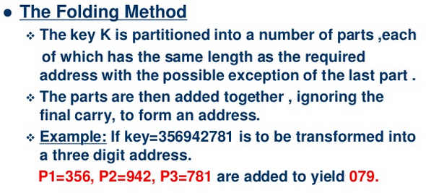
Folding Method

Slide 24
It involves splitting keys into two or more parts and then combining the parts to form the hash addresses.
To map the key 25936715 to a range between 0 and 9999, we can:
split the number into two as 2593 and 6715 and
Add these two to obtain 9308 as the hash value
Very useful if we have keys that are very large.

Slide 25
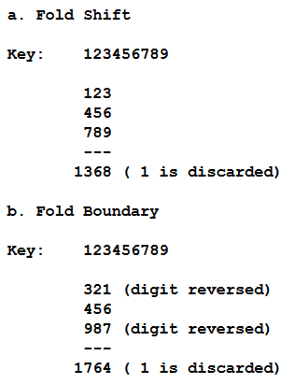
There are two folding methods that are used,
fold shift, the key value is divided into parts whose size matches the size of the required address. Then the left and right parts are shifted and added with the middle part.
fold boundary, the left and right numbers are folded on a fixed boundary between them and the center number.

Slide 26
A good hash function should
Minimize collisions.
Be easy and quick to compute.
Distribute key values evenly in the hash table.
Use all the information provided in the key.

Slide 27
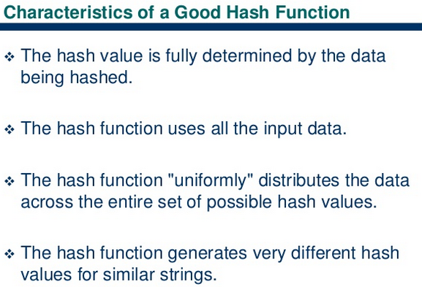

Slide 28
Forms of Hashing
There are 2 different forms of hashing
Open hashing or external hashing
Close hashing or internal hashing
Open Hashing:
It allows records to be stored in unlimited space (could be Hard Disk).
It place no limitation on the size of the table.
Close Hashing:
It uses fixed space to store data.
It limits the size of the table.

Slide 29
Collision in Hashing
When two values hash to the same array location, this is called a collision
Collisions are normally treated as “first come, first served”—the first value that hashes to the location gets it
We have to find something to do with the second and subsequent values that hash to this same location

Slide 30
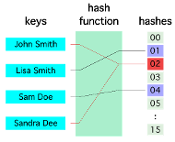
Collision in Hashing
A situation when the resultant hashes for two or more data elements in the data set U, maps to the same location in the has table, is called a hash collision.
In such a situation two or more data elements would qualify to be stored/mapped to the same location in the hash table.

Slide 31
Collision resolution
A collision occur when hashing algorithm produced an address for an insertion key and that address is already occupied.
The memory that contain all the home addresses is known as the primary area.
When two key collide at home address we must resolve the collision by replacing one of the key and its data in another location.
Storing data into another location known as collision Resolution

Slide 32
Collision Resolution methods
Collision Resolution
Open addressing
Linear Probing
Quadratic Probing
Pseudo Random
Key Offset
Bucket
Linked List

Slide 33
Open addressing
Open addressing resolve collisions in the primary area i.e. the area that contain all of the home addresses.
When collision occur the primary addresses are selected for an open or unoccupied element where new data can be placed.
If collision occur, alternate cells are tried until data is placed in memory. Large space is required for open addressing.
There are 4 methods used in open addressing i.e.
Linear probing
Quadratic Probing
Double hashing
Key Offset

Slide 34
Linear Probing
In linear probing when data cannot stored in the home address or demanded address in the hash table then we resolve collision by adding 1 to the current address or place record linearly down whenever the empty location is found.
Example insert 76, 93, 40,47,10 and 55 into hash table of size 7.

Slide 35

Initially hash table with size 7
Key insertion method
ADDRESS=KEY%SIZE_OF_HASHTABLE

Slide 36
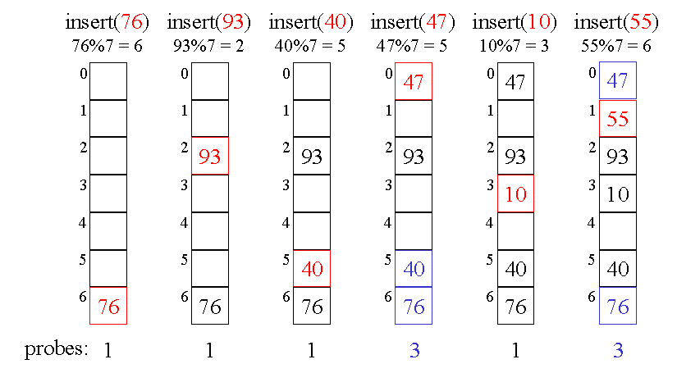
Linear Probing

Slide 37
Linear Probing
Advantages:
It quite simple to implement
Data tend to remain near their home address.
Disadvantages
Problem with linear probing is primary clustering i.e. when many keys mapped to the same location (cluster) linear probing will not distribute these keys evenly in the hash tables.

Slide 38
Primary Clustering
primary clustering is one of two major failure modes of open addressing based hash tables, especially those using linear probing.
It occurs after a hash collision causes two of the records in the hash table to hash to the same position, and causes one of the records to be moved to the next location in its probe sequence.

Slide 39
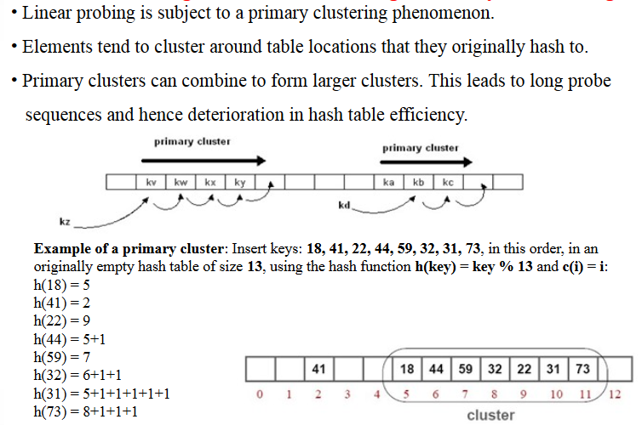

Slide 40
Quadratic Probe
It is a one way to reduced primary clustering
Quadratic probing operated by taking original hash value and adding successive values of an arbitrary quadratic polynomial to the starting value.
Hi(key)=(Hash(key)+i^2)%M
M=size of the hash table or any prime number.
I= integer number from 0 to n

Slide 41
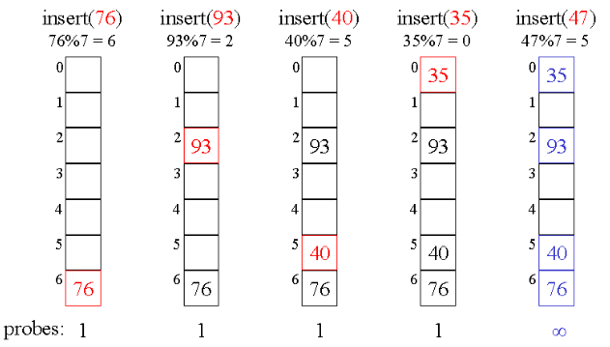
Example ☹

Slide 42
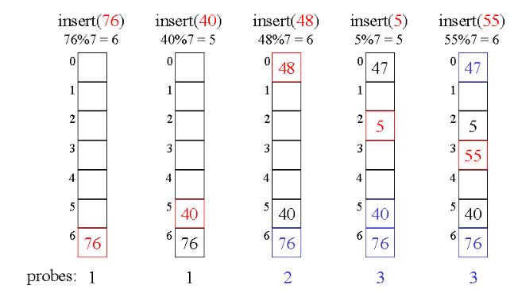
Example ☺

Slide 43
Quadratic Probing
If collision occur then apply Quadratic Probing
Insert 48 consider i=0
(48+0^2)%7=6 already Occupied
(48+1^2)%7=(49%7)=0
48 placed at index 0
Insert 5 and 55 now respectively.

Slide 44
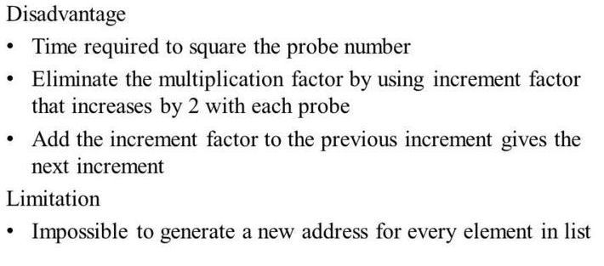
Quadratic Probe

Slide 45
Secondary Clustering
Secondary Clustering is the tendency for a collision resolution scheme such as quadratic probing to create long runs of filled slots away from the hash position of keys.
If the primary hash index is x, probes go to x+1, x+4, x+9, x+16, x+25 and so on, this results in Secondary Clustering.
Secondary clustering is less severe in terms of performance hit than primary clustering.

Slide 46
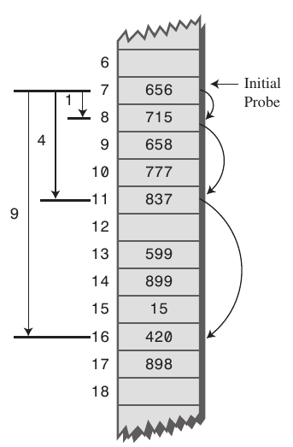

Slide 47
Secondary clustering
A related phenomenon, secondary clustering, occurs more generally with open addressing modes including linear probing and quadratic probing in which the probe sequence is independent of the key, as well as in hash chaining.
In this phenomenon, a low-quality hash function may cause many keys to hash to the same location, after which they all follow the same probe sequence or are placed in the same hash chain as each other, causing them to have slow access times

Slide 48
Elimination of Primary & Secondary Clustering
All types of clustering can be eliminated by double hashing, which involves the use of two hash function h1(key) and h2(key).
h1 is known as primary hash function and is allowed first to get the position where the key will be inserted.
If that position is occupied already, the rehash function
rh(i,key) = (i+h2(key))%table size is used successively until an empty position is found.
As long as h2(key1) doesn’t equal h2(key2),records with keys h1 and h2 don’t compete for the same position.
Therefore one should choose functions h1 and h2 that distributes the hashes and rehashes uniformly in the table and also minimizes clustering.

Slide 49
Pseudorandom collision resolution
The last two method are collectively known as double hashing
Following rules are used for double hashing:
H1(key)=key % Hash_table_size
H2(key)=M-(Key % M)
M=any prime number<hash table size

Slide 50
Example
Create a hash table for 37,90,45,22,49,17
Hash table size =10
Index | Value
0 | 90
1
2 | 22
3
4
5 | 45
6
7 | 37
8
9 | 49
Insert 37,90,45,22,49
Key % 10

Slide 51
Index | Value
0 | 90
1 | 17
2 | 22
3
4
5 | 45
6
7 | 37
8
9 | 49
Insert 17
Key % 10
M-(key%M)

Slide 52
Insert 17
H1(17)=17%10 but it already occupied
Calculate H2
H2(key)=M-(key%M)
H2(17)=7-(17%7)=7-3=4
17 place at index 4 after 37

Slide 53
Key offset
It is also double hashing method that produces different collision path for different keys.
Difference between pseudorandom and key offset?
Pseudorandom generate new address as a function of the previous address
Keyoffset calculate new address as a function of the old address and the key.

Slide 54
Offset=key / list Size
Address=((offset+oldAddress)%listSize)
Example
Key=166702 and list size is 307
Using division modules method 166702%307 gives 1
Key 070918 produce and collision at address 1
Calculate new address using above rules:
Oladdress=070918%307=1
offset=070918/307=231
Address=(231+001)%307=232
070918 key stored in index 232

Slide 55
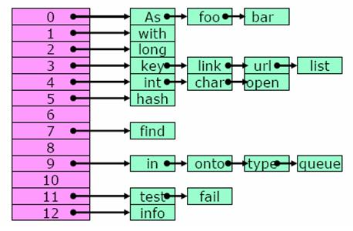
Separate Chaining
The last strategy we discuss is the idea of separate chaining. The idea here is to resolve a collision by creating a linked list of elements as shown below.

Slide 56
Cont..
In the picture above the objects, “As”, “foo”, and “bar” all hash to the same location in the table, that is A[0].
So we create a list of all the elements that hash into that location. Similarly, all other lists indicate keys that were hashed into the same location.
Obviously a good hash function is needed so that keys can be evenly distributed. Because any uneven distribution of keys will neutralize any advantage gained by the concept of hashing.
Also we must note that separate chaining requires dynamic memory management (using pointers) that may not be available in some programming languages.
Also manipulating a list using pointers is generally more complicated than using a simple array.

Slide 57
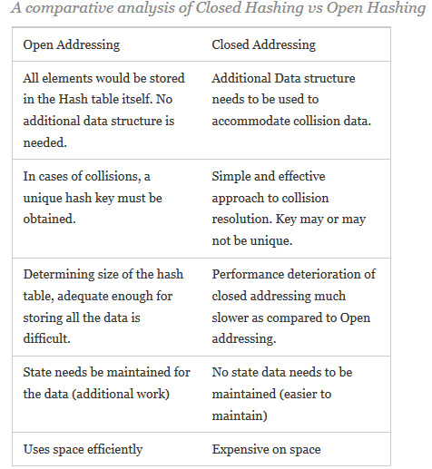

Slide 58
Dictionaries
It is a collection of the forms (k, v) where k is the key and v is the value associated with the key (equivalently, v is the value whose key is k).
No two pairs in dictionary have the same key.
Operations are performed on dictionary
Determine whether dictionary is empty or not
Determine the dictionary size.
Find the pair with specific key.
Insert pair into the dictionary.
Delete the pair from dictionary.

Slide 59
Cont..
The word dictionary is a collection of pairs; each pair comprises a word and its value.
The value of the world include the meaning of the world, the pronunciation, verbal nouns, and so on.
Examples :
Webster’s dictionary
Telephone dictionary

Slide 60
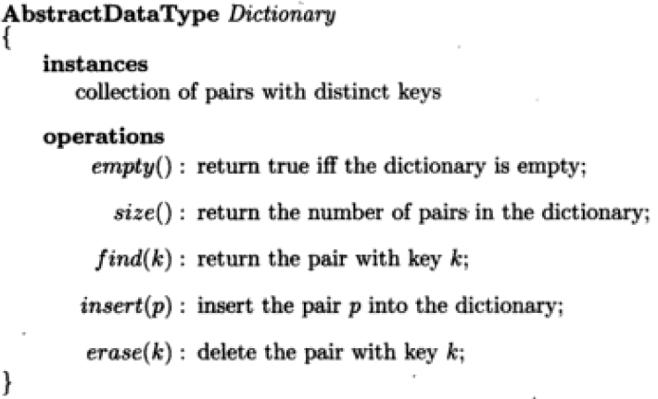
Dictionary ADT

Slide 61
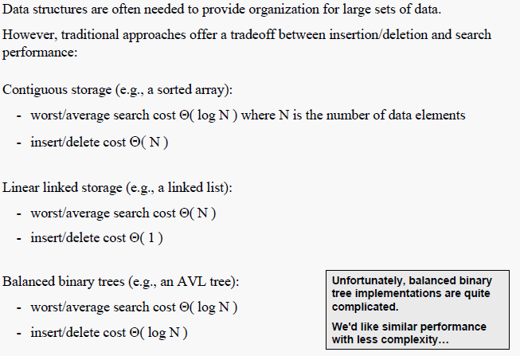
Skip List Motivation

Slide 62
Skip List
Skip lists were invented in 1990 by William Pugh.
This data structure makes random choices in arranging the entries in such a way that search and update times are O(1ogn) on average, where n is the number of entries in the dictionary.
A skip list is a linked list sorted by keys. Each node is assigned a random height, up to some maximum. The number of nodes at any height decreases exponentially with that height.
A skip list node has one successor at each level of height.
For example, a node of height 3 has three next pointers, one to the next node of height 1, and another to the next node at height 2, and so on.

Slide 63
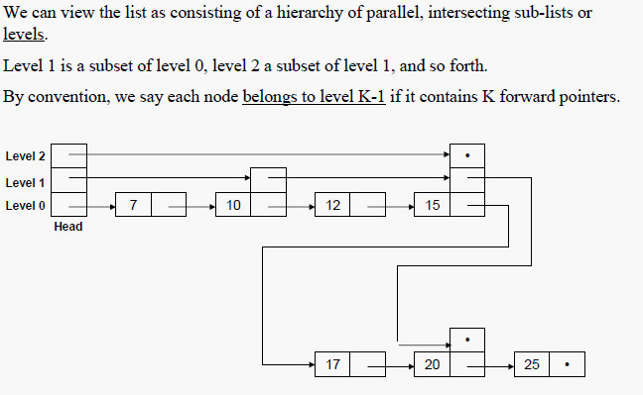
Skip List

Slide 64
Skip List
Skip lists are made up of a series of nodes connected one after the other. Each node contains a key/value pair as well as one or more references, or pointers, to nodes further along in the list.
The number of references each node contains is determined randomly. This gives skip lists their probabilistic nature, and the number of references a node contains is called its node level.
Two nodes that are always present in a skip list are the header node and the NIL node.

Slide 65
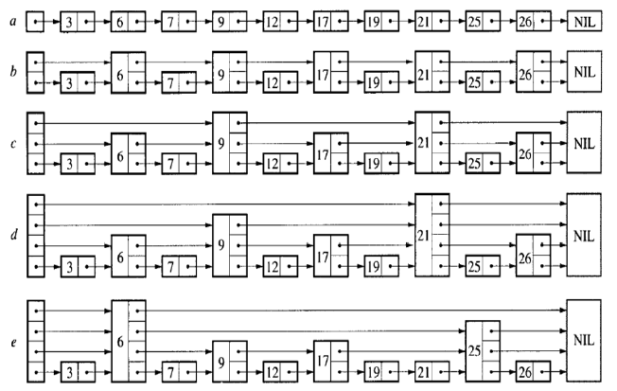
Examples

Slide 66
Searching in Skip List
Searching for a key within a skip list begins with starting at header at the overall list level and moving forward in the list comparing node keys to the search key.
If the node key is less than the search key, the search continues moving forward at the same level.
If on the other hand, the node key is equal to or greater than the search key, the search drops down one level and continues forward.
This process continues until the search key has been found if it is present in the skip list.
If it is not, the search will either continue to the end of the list or until the first key with a value greater than the search key is found.

Slide 67
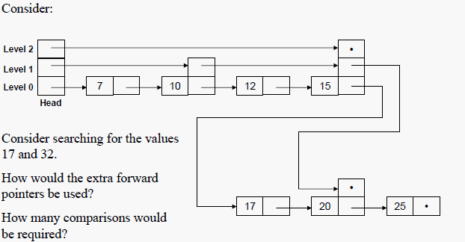
Example
Consider given skip list

Slide 68
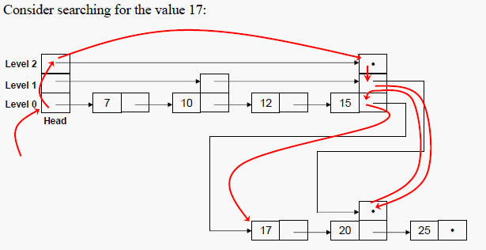

Search 17

Slide 69
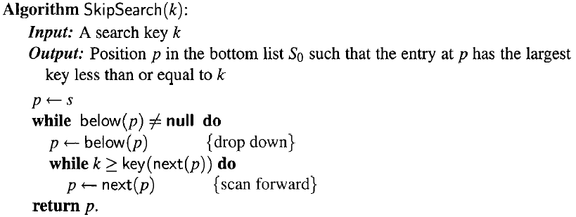
Algorithm of Searching

Slide 70
Complexity in Searching
To search for an element with a given key
Find location in top list. Top list has O(1) elements with high probability. Location in this list defines a range of items in next list. Drop down a level and recurse
O(1) time per level on average
O(log n) levels with high probability
Total time: O(log n)

Slide 71
Insertion in Skip List
Insertion begins with a search for the place in the skip list to insert the new key/value pair.
The search algorithm is used with one change: an array of nodes is added to keep track of the places in the skip list where the search dropped down one level.
This is done because the pointers in those nodes will need to be rearranged when the new node is inserted into the skip list.

Slide 72
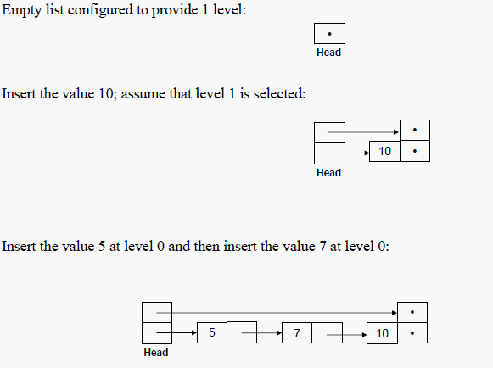
Example

Slide 73
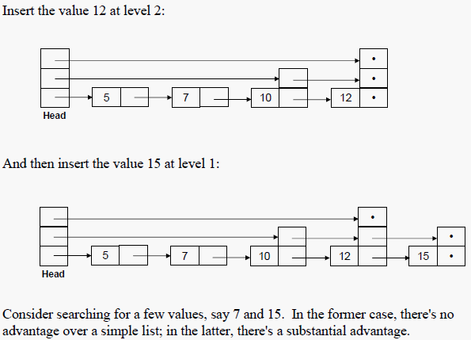
Cont..

Slide 74
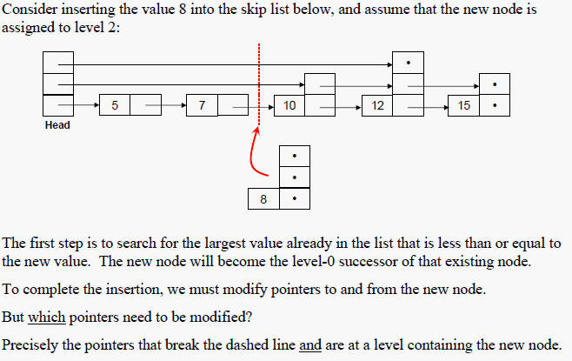
Insert new node in skip list

Slide 75
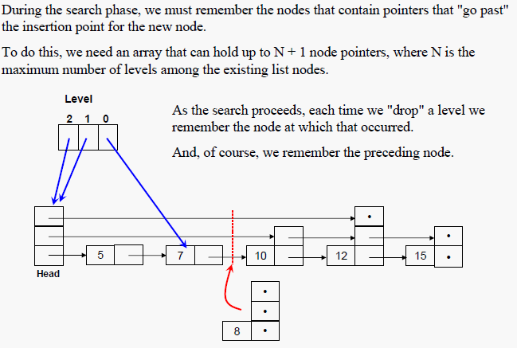
Remember Passing Parameters

Slide 76
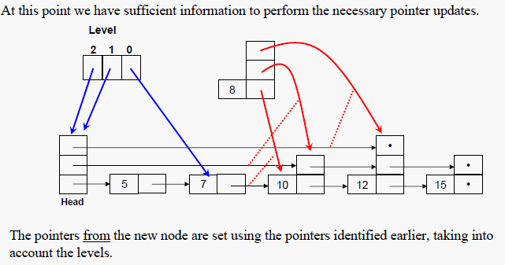
Updating pointer during insertion

Slide 77
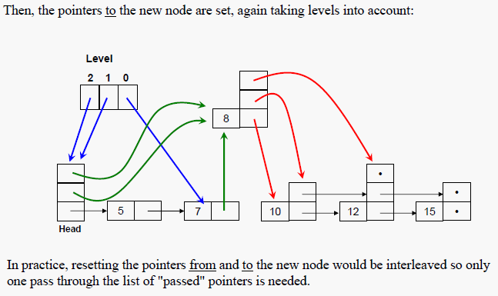

Slide 78
Complexity
Do a search for that key
Insert element in bottom-level list
With probability p, recurse to insert in next level
Expected number of lists = 1+ p + p2 + … = 1/ (1-p) = O(1)
if p is constant
Total time = Search + O(1) = O(log n) expected
Skip list delete: O(1)

Slide 79
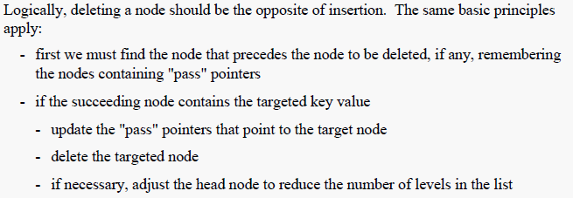
Deletion in skip list

Slide 80
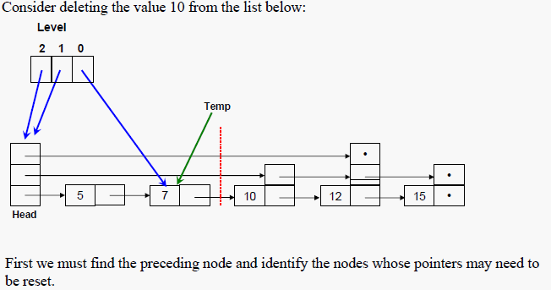
Example

Slide 81
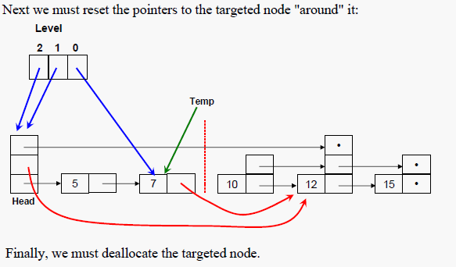
Cont..

Slide 82
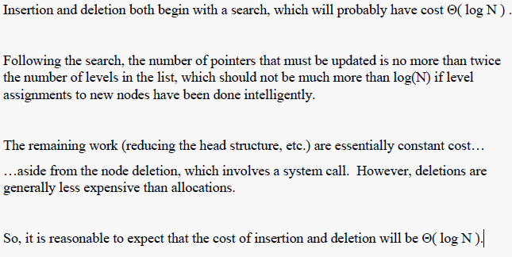
Insertion/Deletion Performance

Slide 83
Applications in some fields
Q-Map - The QMap class is a value-based template class that provides a dictionary
Skip DB - It is an open-source database format using ordered key/value pairs

